Slide 1
Bash Help GUI
Waikato Linux Users Group
Ian Stewart
22 Aug 2022

Slide 2

Bash Help GUI
Retrieve all the bash commands:
$ & <tab>
$ compgen -c
Note: Using Manjaro with zsh, not Ubuntu with bash

Slide 3
Bash Help GUI
Using a Python function to return output of compgen
from subprocess import check_output
def get_compgen_list():
output = check_output('compgen -c', shell=True, executable='/bin/bash')
command_list_byte = output.splitlines()
# Convert from bytes list to string list
command_list_str = []
for item in command_list_byte:
command_list_str.append(item.decode("utf-8"))
# Remove duplicates in the list
command_list = list(dict.fromkeys(command_list_str))
# Sort the list
command_list.sort()
return command_list

Slide 4
Bash Help GUI
Using a Python function to return output of compgen
MESSAGE = ("\nA total of {} bash commands have been identified."
.format(len(bash_command_list)))
print(MESSAGE)

Slide 5
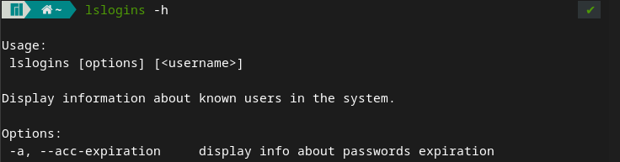
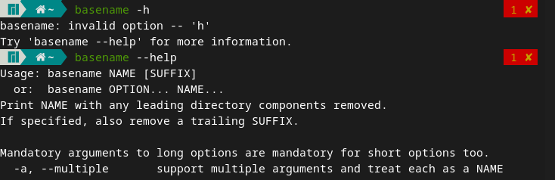
The –h and - –help convention. E.g.

Slide 6
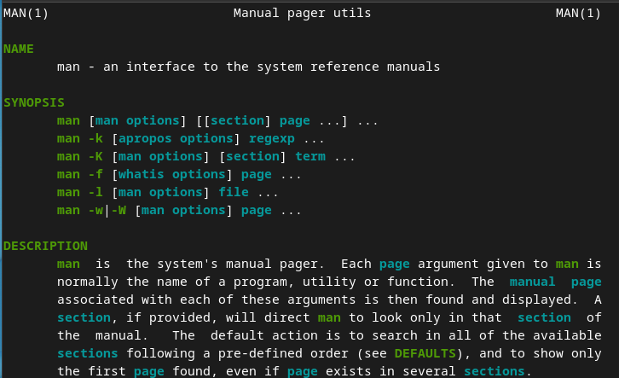
man pages. E.g.

Slide 7

whatis. E.g.

Slide 8
Bash Help GUI Program
Program Objectives:
Collect all the bash commands using compgen
Clean up the list and convert to a dictionary
Launch a GUI and place the dictionary in the tree.
  Upon selection of an item in the tree, display in a Text viewer:
  whatis description
  -h information
  —help information
  man pages
Also provide a search field

Slide 9
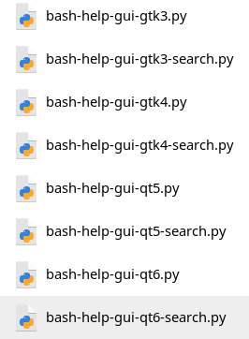
Bash Help GUI Program
Program Versions available:

Slide 10
Bash Help GUI Program
Repository: https://github.com/WLUG/meetings/tree/master/2022/2022-08-22/ian

Slide 11
Bash Help GUI Program
Demo program

